Slide 1
Public Laws for Mass Gatherings
Student’s Name
Institutional Affiliations

Slide 2
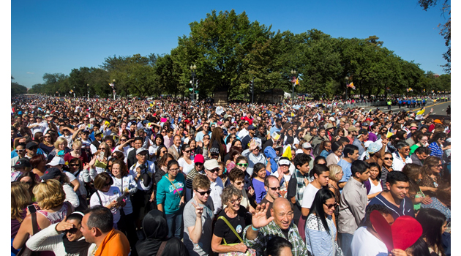
Introduction
One of the largest mass gathering done in Saudi Arabis is the Hajj
The Hajj is performed every year
People come from different countries to be involved with the events
Public health laws have been put in place to ensure the safety of the pilgrims
Some of the laws include coronavirus regulations and travel laws
Notes:
Hajji is a religious pilgrimage that is conducted to Mecca in the kingdom of Saudi Arabia. The event is handled after every year and thus, being the largest pilgrimage worldwide, people from different parts of the world assemble in the area. llThis creates a mass gathering and without strict health laws, individuals may get sick and even die. To reduce this challenge, the government and public health had to develop regulations that will ensure all the pilgrims are safe and control the population, especially during this coronavirus pandemic. The Umrah is also a pilgrimage to Mecca that can be done at every time of the year. Nevertheless, it was not careful as Hajj. The laws developed, such as the travel rules and coronavirus regulations are essential in guaranteeing people are safe, and thus failing to follow the directions will have consequences. This presentation will focus on the public health laws in place in Saudi Arabia for religious pilgrims.

Slide 3
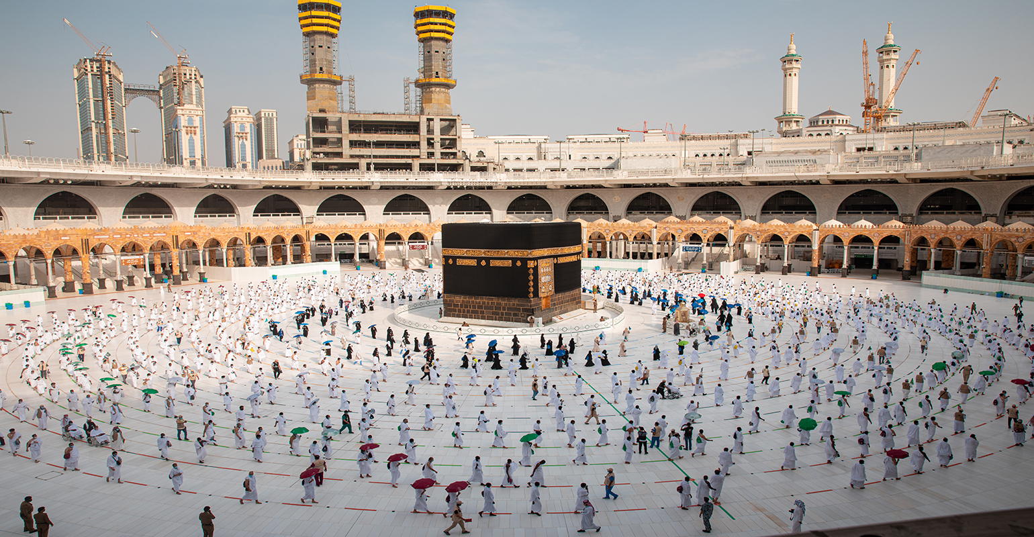
Public Health Laws In Saudi Arabia
Meningococcal meningitis regulations
Travel rules
Coronavirus laws
Notes:
Several laws have been established with public health to protect its citizens and the country in general. While people come from different countries, different pandemics might be occurring in their regions, which can be carried away and transmitted in the Kingdom of Saudi Arabia. With all consideration, there is a need to control the number of people by developing restrictions that ensure only individuals with the intended purpose are allowed. Some of the public health laws presented include meningococcal meningitis regulations, travel rules which will focus mostly on the visa cards, coronavirus laws to reduce the increased transmission of the virus and religious requirements to be followed, especially for ladies by healthcare rules. Similarly, the king of Saudi Arabia has also provided recommendations that people must follow, especially during the event's preparation process, to avoid excess congestion in the healthcare facility setting. All this helps to prevent any disease transmission.

Slide 4
Meningococcal Meningitis Regulations
The disease is caused by a bacterium called Neisseria meningitis (Rahman et al., 2017)
The bacteria is known for causing large epidemics
The disease is transmitted through respiratory droplets and cough secretions
One person can cause immense suffering during the pilgrims
Many restrictions have been put in place to ensure nobody comes with the bacteria
Notes:
Many diseases worldwide have an immense risk of spreading to the people in the Kingdom of Saudi Arabia. Therefore, Meningococcal Meningitis can cause significant suffering, especially in mass gatherings such as that of Pilgrim. Hence, requiring strict measures and laws from the public health department. The disease is caused by a bacterium called Neisseria meningitis and is widely spread in sub-Saharan Africa (Rahman et al., 2017). The condition is widely known for causing large epidemics and thus, prevention is better within the borders and ensures people attending the mass gatherings are immunized. Mass meetings have more risks of the disease because of transmission as it is transmitted through respiratory droplets that appear through coughing or talking. Also, the condition can be shared by staying close to the carrier. The spread of the disease is enhanced by mass gatherings such as the Hajj pilgrimage. Moreover, the disease symptoms occur fast with an average incubation time to be four days, but it can prolong up to ten days.

Slide 5
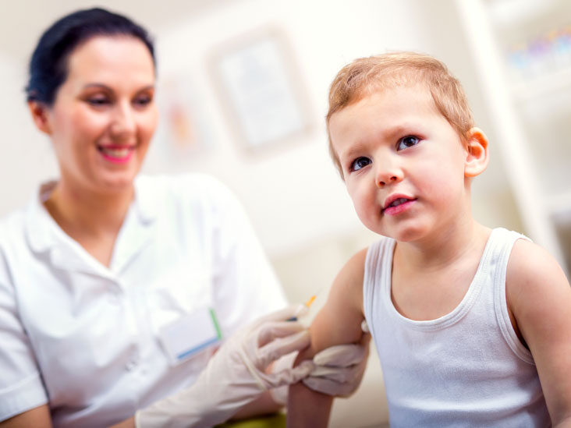
Meningococcal Meningitis Regulations Cont…
Every person coming from other countries must provide the certificate of vaccination
The certificate should be issued less than three years and more than ten days (Saudiembassy, n.d)
The purpose of the law is to ensure safety for people in mass gatherings
All people have to provide the requirements before entering the country
The implication is not attending the Hajj
Notes:
The law developed by public health is essential in safeguarding the Hajj pilgrimage. Considering that the religious meeting is deemed holy and people will come from different places, the laws are executed at the border. Therefore, the first law requires that every person coming from other countries provide a vaccination certificate for meningococcal meningitis. The certificate will prove that the person is virus-free. However, the certificate requirement is that the vaccination should be conducted within ten days to three years (Saudiembassy, n.d). But it will be considered invalid and void if not within that range. The purpose of this law is to ensure Saudi Arabian citizens are safe during the mass gathering. The implications for defying this law are missing the pilgrimage as one cannot be allowed to enter Saudi Arabia because all people will have to provide the stated requirements before entering the country. Every citizen of the country attending the gathering and have not been vaccinated for the past three years will have to receive the quadrivalent vaccine.

Slide 6
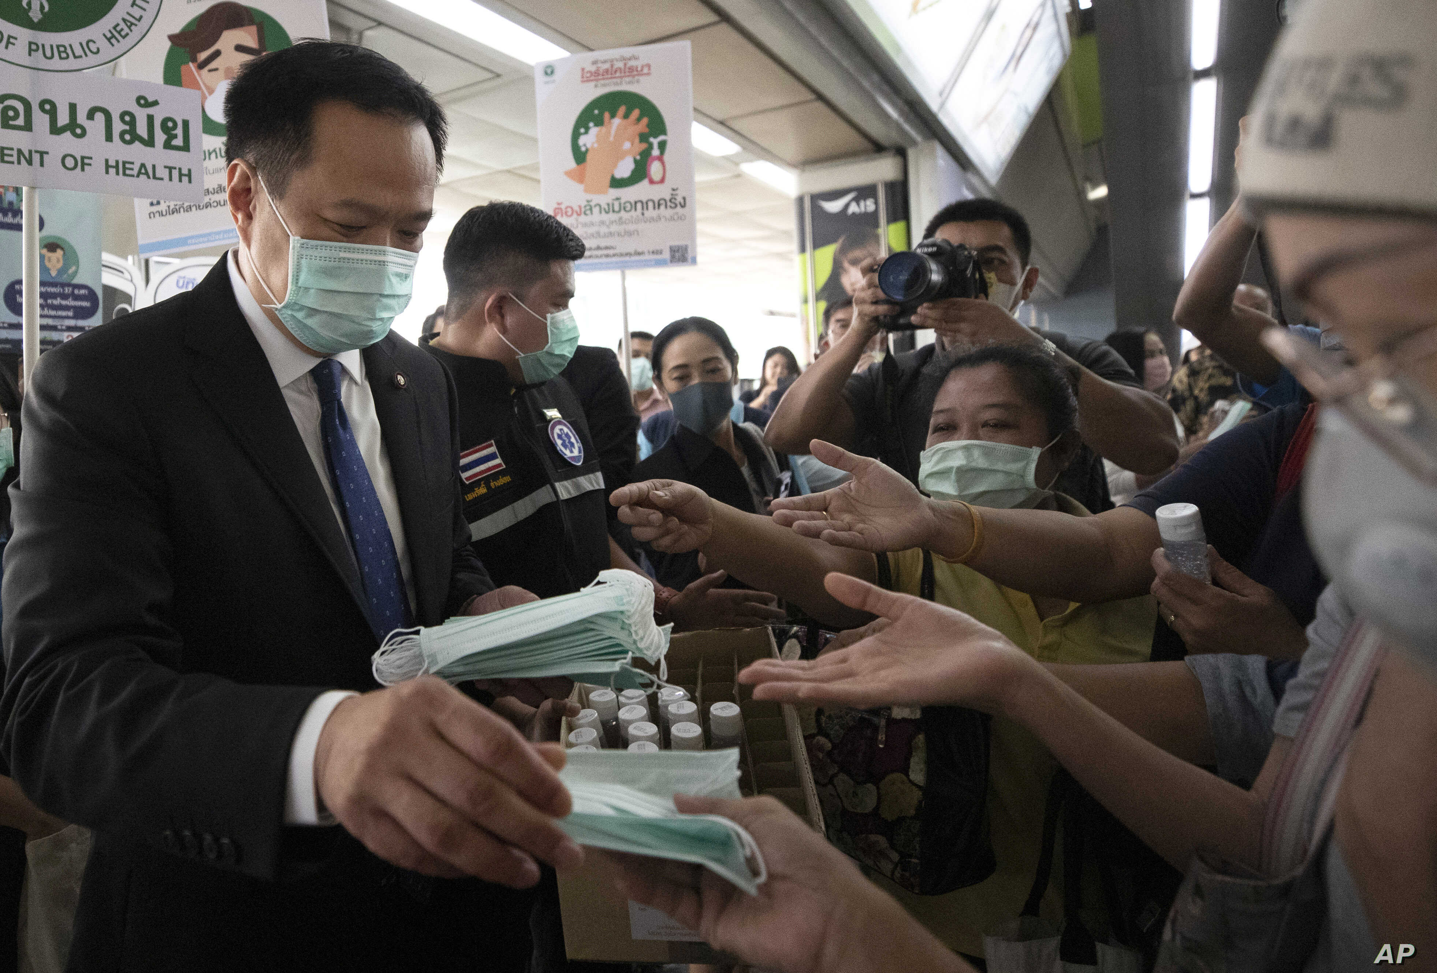
Coronavirus Laws
Keep a social distance of at least 1.5meters
Wear masks throughout
Wash hands with soap and water regularly
Utilize disposable tissue when sneezing and coughing
Notes:
The coronavirus pandemic has resulted in significant changes in the way people live and the laws. Therefore, the Kingdom of Saudi Arabia is no exception as the disease requires health laws to be changed and implemented to ensure individuals can be safe. The coronavirus is a respiratory disease that transmits through the respiratory droplets when a person coughs or sneezes. Therefore, the public health laws implemented include maintaining the social distance of a minimum of 1.5 meters from one person to another. Also, individuals are required to wear masks during a mass gathering to avoid disease transmission. Since the disease is transmitted through droplets, individuals must wash their hands or regularly disinfect, especially when they sneeze. Also, use disposable tissue to sneeze and place it in a safe place. Lack of following these laws can make a person sick hence requires self-discipline. Public health has managed to contain the spread of the disease during the 2020 Hajj pilgrimage.

Slide 7
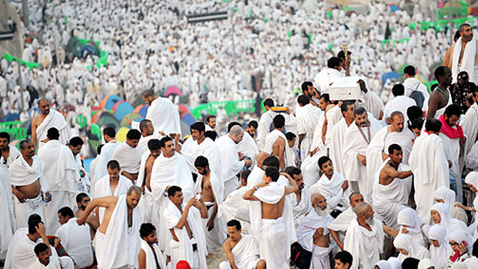
Pilgrimage Attendance Population Laws
The following population were not required to attend mass gatherings:
Pregnant women
Individuals with chronic conditions
People with more than 65 years (Ebrahim & Memish, 2020)
Children with less than 12 years
Notes:
The coronavirus pandemic has affected the whole world coming from different researches that have been conducted worldwide. About five hundred thousand people have died of the disease, hence creating a lot of tension. As a result, the government has restricted mass gatherings, thus causing extreme changes in the public health laws as people have to improve on their hygiene. Similarly, social groups have also faced restrictions based on the population needed and the age limit. The Hajj attendance was limited extensively. For example, pregnant women and individuals with chronic conditions such as diabetes were not required to attend due to their repercussions. Another vulnerable population affected was people more than sixty-five years and children less than twelve years were not necessary to participate in the mass gathering (Ebrahim & Memish, 2020). The purpose of these laws is for the people's safety and thus no access if they are not followed.

Slide 8
Travel Rules
Individuals attending a mass gathering coming from a different country must be vaccinated for yellow fever
A certificate of vaccination is presented and must be within ten days and ten years
The purpose of this law is to reduce the spread of infection to other people
The implication of the law is to be put in strict surveillance for six days
Notes:
The travel sector is among the industry that facilitates mass gathering. People need to travel from one region to another to attend such events. Therefore, some come from countries with yellow fever infection, making it unsafe for them to interact with the whole gatherings. However, to avoid the challenges, public health has implemented a law that will make people present the yellow fever certificate that is valid if an individual was vaccinated within ten days and ten years. Failure to observe these laws will expose an individual to up to six days of strict surveillance from the vaccination day of the likelihood of being exposed to the infection. The transportation mediums are not left behind because they have to present a certificate of disinfection based on the world health organization's procedures in collaboration with the King Saudi Arabia ministry of health. Hence health of the attendants is an aspect handled with a high level of precaution.

Slide 9
Health Instructions Provided By International Organizations
Water and sanitation (Memish et al., 2019)
The spread of communicable disease
Mental health and psychosocial disorders (World Health Organization, 2015)
The advice is reflecting the laws because it has focused on maintaining hygiene and prevent diseases
Notes:
The instructions provided by the international organization about protecting public health in the mass gathering are essential and revolves around three things. During the mass gathering, people tend to get congested hence affecting hygiene. Therefore, the first instruction presented is to ensure water and sanitation (Memish et al., 2019). Clean water is vital in boosting hygiene because people will have access to water for washing their hands and performing their daily activities. However, lack of clean water can result in an eruption of other diseases such as typhoid. Another health risk associated with mass gathering is the rise of infectious diseases such as hypertension, leading to significant challenges in an individual's life. Moreover, mental health challenges are an increasing problem as many people tend to deal with individuals who have different characters causing them to suffer from stress (World Health Organization, 2015). The advice presented reflects the laws because in many laws' protection is against reducing the spread of the disease, especially to individuals from different countries.

Slide 10
References
Ebrahim, S. H., & Memish, Z. A. (2020). Saudi Arabia’s drastic measures to curb the COVID-19 outbreak: temporary suspension of the Umrah pilgrimage. Journal of Travel Medicine, 27(3), taaa029.
Fitfortravel. (n. d). Hajj and Umrah Pilgrimage. Fitfortravel. https://www.fitfortravel.nhs.uk/advice/general-travel-health-advice/hajj-and-umrah-pilgrimage
Memish, Z. A., Steffen, R., White, P., Dar, O., Azhar, E. I., Sharma, A., & Zumla, A. (2019). Mass gatherings medicine: public health issues arising from mass gathering religious and sporting events. The Lancet, 393(10185), 2073-2084.
Rahman, J., Thu, M., Arshad, N., & Van der Putten, M. (2017). Mass gatherings and public health: Case studies from the Hajj to Mecca. Annals of global health, 83(2), 386-393.
Saudiembassy (n.d). Hajj and Umrah Health Requirements. The Embassy of the Kingdom of Saudi Arabia. https://www.saudiembassy.net/hajj-and-umrah-health-requirements#:~:text=A)%20Visitors%20from%20all%20countries,before%20arrival%20in%20Saudi%20Arabia.
World Health Organization. (2015). Public health for mass gatherings: key considerations.

